Slide 1

Azure Certification
Sarah Lean & Gregor Suttie

Slide 2

Sarah Lean
Cloud Solution Architect
Blogger | Curler | Photographer | Book Lover | Runner | Speaker |
13+ years experience in IT
@TechieLass
https://www.techielass.com

Slide 3

Gregor Suttie
Head of Development Services for Sword UK
Blogger | Speaker | Azure Fan Boy | Golfer 23 years experience in IT
@gregor_suttie
https://www.gregorsuttie.com

Slide 4
Announcing 4 new Azure job role certifications and training
COMING SOON
Azure Administrator
Azure Developer
Azure Solutions Architect
Azure DevOps Engineer

Slide 5
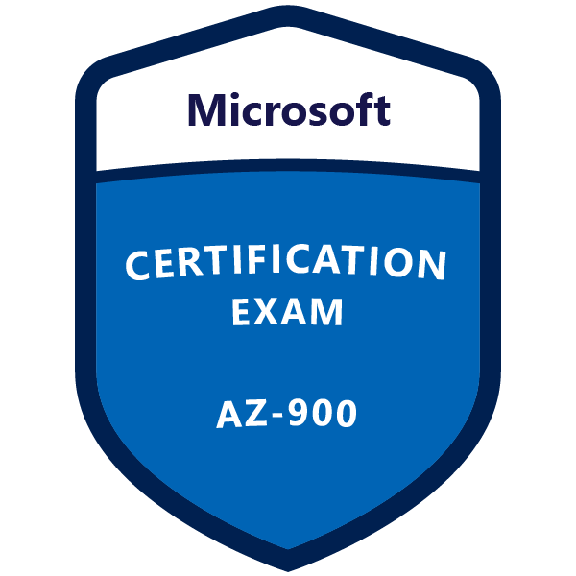
AZ-900 – Azure Fundamentals
Standalone exam
Covers things such as
Cloud Concepts
Core Azure Services
Security & Compliance
Privacy
Azure Pricing
Great exam for those new to Azure

Slide 6

Azure Administrator
Courses Prep for Certification
Exams
Certification
Implement and Manage Storage
Configure and Manage VNets
AZ-100: Microsoft Azure Infrastructure and Deployment Exam
Manage Subscriptions
Deploy and Manage VM
Manage Identities
Available as online courses and instructor-led training
Microsoft Certified: Azure Administrator Associate
Advanced
Networking
Secure Identity
Migrate VMs
App Services
AZ-101: Microsoft Azure Integration and Security Exam
Transition Exam Available:
70-533 – take AZ-102

Slide 7
Learning path for Azure Developer role
Courses Prep for Certification
Exam
Certification
Platform as a Service (PaaS) Solutions
Azure cloud model
Azure services and third-party services
Cloud storage
Secure cloud solutions
Monitor, troubleshoot, and optimize solutions
AZ-203: Developing Solutions for Microsoft Azure
Available as online courses and instructor-led training
Microsoft Certified: Azure Developer Associate
Cloud integration solutions
Azure Infrastructure as a Service compute solutions
Azure storage
Azure Cognitive Services, Bot, and IoT solutions
Azure Platform as a Service compute solutions
Azure security

Slide 8
Azure Solutions Architect
Courses Prep for Certification
Exams
Certification
Workloads and Security
Deploy Apps
Developing for the Cloud
AZ-300: Microsoft Azure Architect Technologies Exam
Configure Infrastructure
Technology Solutions
Secure Data
Available as online courses and instructor-led training
Microsoft Certified: Azure Solutions Architect Expert
Identity and Security
Data Platform Solution
Deployment, Migration, and Integration
Infrastructure Strategy
AZ-301: Microsoft Azure Architect Design Exam
Transition Exams Available:
70-535 – take AZ-302

Slide 9
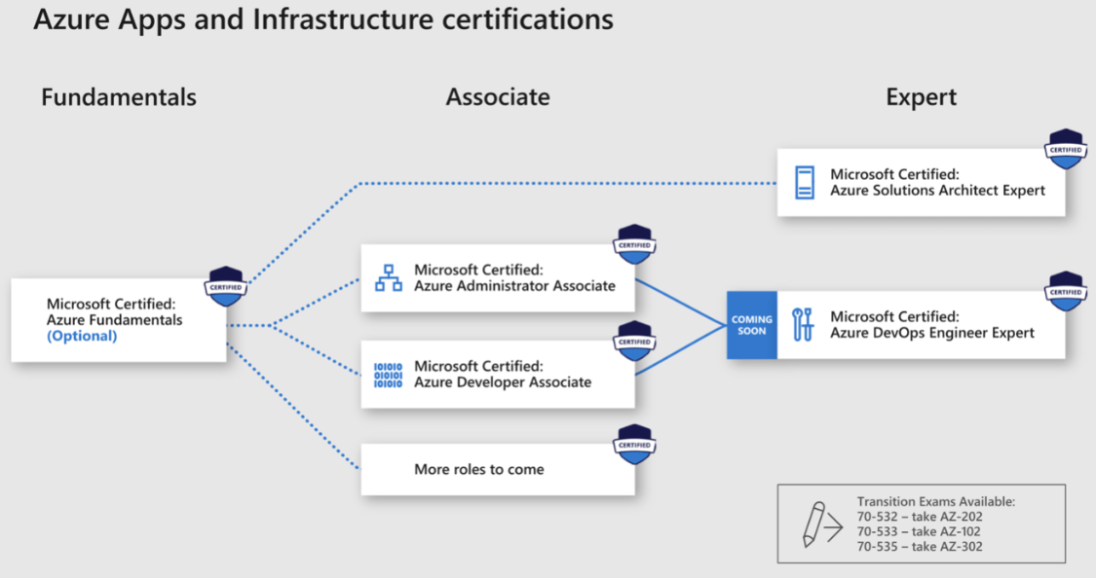

Slide 10
Cloud + Certification = Opportunity
+
=
Cloud
Skills Shortage
Opportunity
70% of CIOs plan a “cloud-first strategy”
85% of enterprises will have cloud architecture
By 2021 38% of IT positions will be cloud related
Only 16% of organizations have required skills and processes
2017 IDC-Microsoft, Cloud Skills and Organizational Influence: How Cloud Skills Are Accelerating the Careers of IT Professionals white paper

Slide 11

28th February 2019 https://techug.org.uk/

Slide 12



Thank you!
http://bit.ly/Feb19Feedback
See you in April!

